Slide 1
Server Automation
Design by: Jiri Caga

Slide 2

Introduction
Automated repeat parts and faster develop
Easy run external web server
Synchronization pages(xhtml, css, image) on background

Slide 3
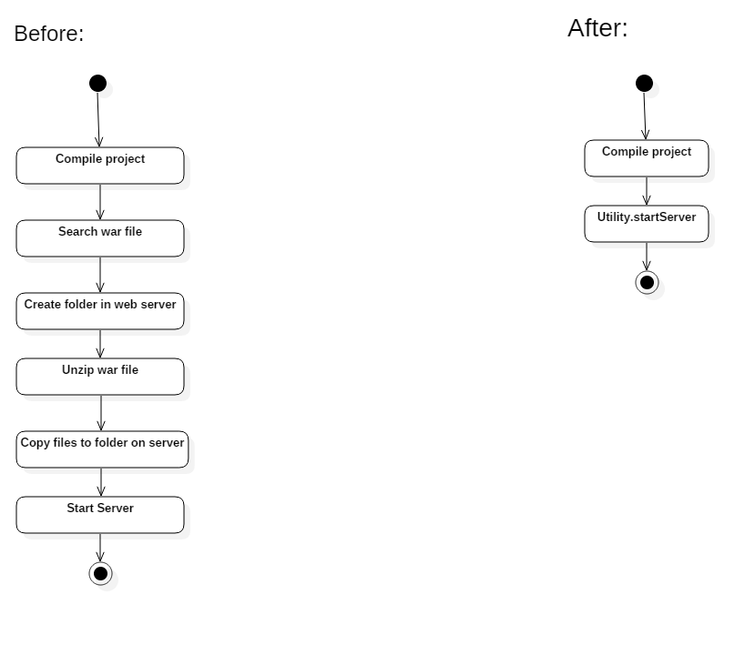

Compare situations

Slide 4
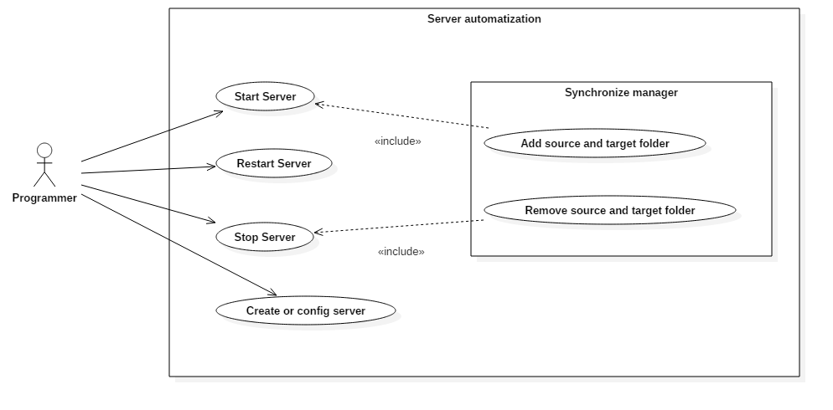
Use case diagram

Slide 5
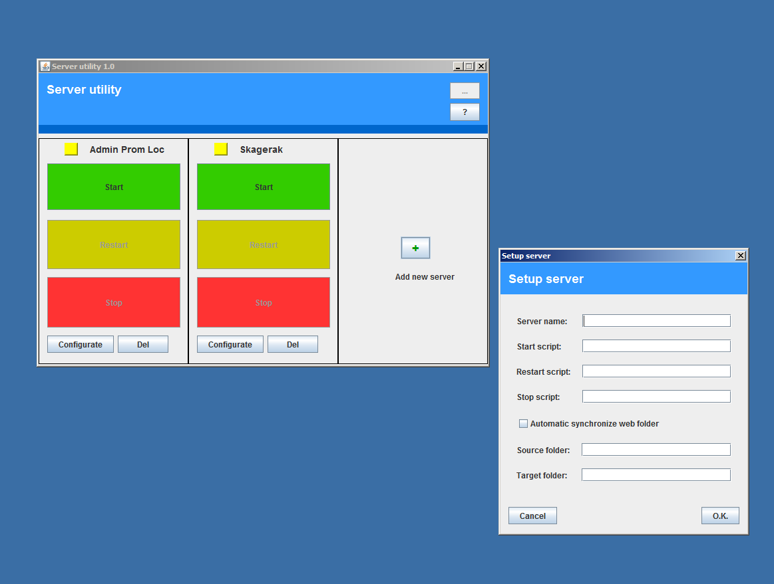
Show app

Slide 6



Technologies
Design pattern in code
JAVA
Swing
XML

Slide 7

Conclusion
The Server Automation is used for simplify and acceleration develop frond-end application, when programmer often make changes on page.
https://github.com/JiriCagis/ServerUtility

